Slide 1
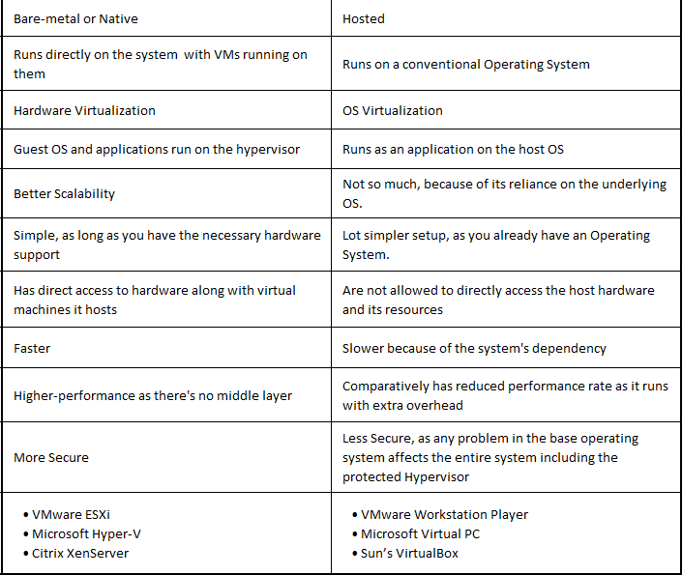
Type 1 HV
Type 2 HV

Slide 2
Type 1 | Type 2
Type-1 hypervisors are most suited for enterprise setups | Type-2 hypervisors are best suited for personal/small deployments.
IT organizations use Type 1 hypervisor for production level workloads | Type 2 for creating virtual desktops

